Slide 1
Chapter 2
Bus Systems and Devices

Slide 2
ARM based Hardware architecture
ARM series of processors has become popular.
The Raspberry Pi (Rpi) uses the ARM processor manufactured by Broadcom.
The RPi is the size of a credit card and can run the Linux operating system.
For industrial use, the designers came up with the Compute Module 3 (CM3)
Notes:
ARM processor is the one of the most popular processor, particularly used in portable devices due to its low power consumption and reasonable performance.
The Raspberry Pi uses the ARM Cortex A series of processors manufactured by Broadcom.
The Raspberry Pi is a low cost, credit-card sized computer that plugs into a computer monitor or TV, and uses a standard keyboard and mouse. The Raspberry Pi can run an operating system, for example the Linux operating sytem is a popular choice as an operating system.
For industrial use, the designers came up with the Compute Module 3 (CM3), which is a Rpi with a smaller formfactor and which has much less built in peripherals than the RPi. Much more processor pins are available for use, lowers the cost of the board making it more flexible for custom designs

Slide 3
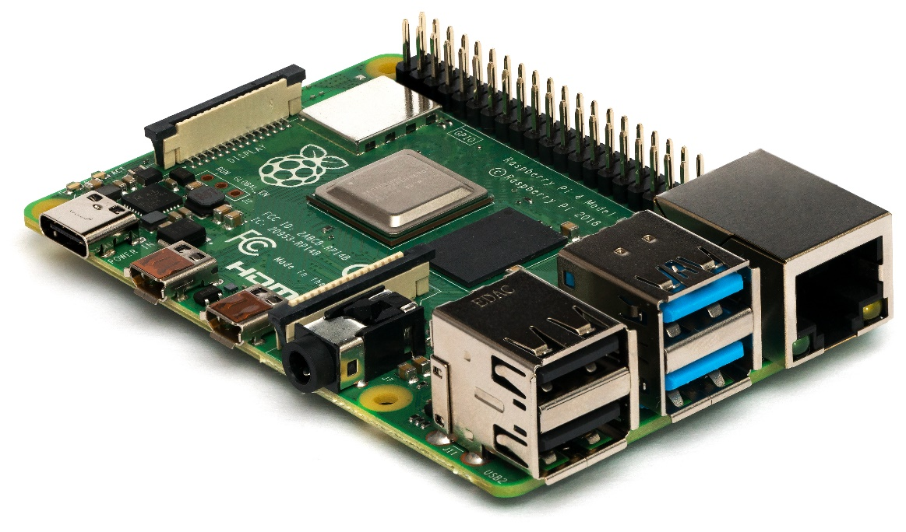
ARM processor
RAM
Ethernet Port
HDMI Ports
USB Ports
Raspberry Pi
Notes:
The picture shows the Raspberry Pi single board computer, specifically the Raspberry Pi 4 Model B SBC. Here, you can see the microprocessor or the brain of the raspberry pi, the RAM or Random Access Memoery, the USB ports, the Ethernet port and the HDMI ports among others.
Raspberry Pi SBCs feature a Broadcom system on a chip (SoC) with an integrated ARM-compatible central processing unit (CPU) and on-chip graphics processing unit (GPU).
Although often pre-configured to operate as a headless computer, the Raspberry Pi may also optionally be operated with any generic USB computer keyboard and mouse. It may also be used with USB storage, USB to MIDI converters, and virtually any other device/component with USB capabilities, depending on the installed device drivers in the underlying operating system (many of which are included by default).
Other peripherals can be attached through the various pins and connectors on the surface of the Raspberry Pi.

Slide 4
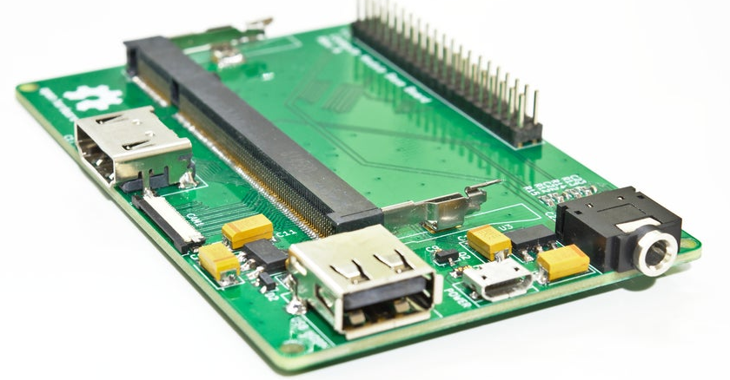
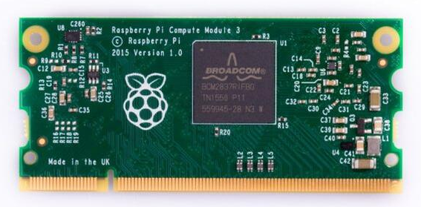
The Raspberry Pi Compute module and its carrier board
Notes:
On the right of this picture is the Raspberry Pi Compute Module, or more specifically the Compute Module 3 or CM3.
The picture on the left shows the carrier board, or base board. The CM3 can be inserted onto the base board connector as shown.
The Raspberry Pi Compute Module has seen utilized in the industrial area due to its form factor, and its ability to easily replace and update the hardware design on the carrier board
With the full flexibility of the Raspberry Pi CPU, this means more GPIOs and interfaces available compared to the Raspberry Pi board allowing users to design the module into a custom system easier.
In the lab practicals, we will be using the compute module and the carrier board.

Slide 5
Notes:
The Broadcom processor used in the Raspberry Pi CM3 has a CPU which uses an ARM Cortex A core which follows the ARMv8-A architect.
Here is a list of hardware blocks which typically make up the processor., some of which are also found in other microcontrollers like the pic18F which you had learnt previously.
For example, the memory, the general purpose input output or GPIO and the pulse width modulataion or PWM

Slide 6
ARM AMBA BLOCK DIAGRAM
Notes:
One key factor to successfully develop embedded systems is to achieve an efficient communication between processors and their peripherals.
On the Broadcom processor, an on-chip bus transfers data between these various blocks using hardware based on a bus architecture designed by ARM called AMBA or Advanced Microcontroller Bus Architecture. This in turn specifies other interfaces to external devices like the Advanced eXtensible Interface (AXI) which allows interfacing to external memory devices like the NAND Flash.
An AXI to APB bridge (or interface) on one of the slave port is normally used to bridge communications to a set of peripherals shared on an APB bus.

Slide 7
THE 8080 INTERFACE
Notes:
The 8080 bus is a popular interface for peripherals.
Devices that interface using the 8080 mode include the graphical liquid crystal displays (LCD) and various types of flash memories.
The "8080" interface is used because of their simplicity and modest hardware requirements
The 8080 originally specified the bus widths and control signals as shown on this slide.
The address bus has a width of 16 bits, giving a total of 2^16 which equals 64Kb of memory
For devices in current use, the full width of the address and data busses can vary. For example, the data bus may be 8, 9 or 16 and 18 bits.

Slide 8
Memory and I/O mapped I/O
Memory mapped I/O | I/O mapped I/O
Uses processor’s main memory address space for I/O | Uses separate address space for I/O
May interfere with program memory allocation. We have to take note of “special” locations that are not standard memory (but I/O instead). | No such worries as all address in I/O map is I/O, and all addresses in memory map is memory
Need to use flexible addressing modes to access data. | Normally all data passes through accumulator - can be slow.
Notes:
The 8080 bus makes a distinction between addressing memory and I/O devices by having an IO/M signal. The IO/M signal was shown in the previous slide
The 8080 has a different instructions for accessing these devices as they allow for greater flexibility in accessing I/O. Firstly, memory mapped I/O
allows the use of the interfacing device as if it were a memory device using standard load/store/move instructions in assembler, or high level language assignment statements. Displays are a typical example of this sort of device.
Second, I/O mapped instructions take the form of “input” or “output” instructions.
A comparison between the two modes of addressing is shown in the table here.

Slide 9
Memory devices

Slide 10
Types of Memory devices
RAM ROM
Volatile yes no
Random Access yes yes
Read by processor yes yes
Write by processor yes no
RAM Types: static and dynamic RAM
ROM Types: PROM, EPROM, EEPROM, Flash

Slide 11
EEPROM Types
Access
Technology
Availability

Slide 12
EEPROM Types

Slide 13
Buffers and latches

Slide 14
Buffer and Latch
“0”
Active Low
“0”
“0”
“1”
“1”
“0”
Active High
“0” or “1”
High Impedance
“1”
Bi-directional Buffers
Tri-state Buffers

Slide 15
Edge triggered latch
Input
Output
Input
Output

Slide 16
Input Port using Buffer

Slide 17
Output Port using Latch

Slide 18
Monitor programs & bios

Slide 19
Monitor Program
A simple basic program residing in ROM of Microprocessor
Fundamental tasks
simple output to the screen
keyboard handling
output to printer
serial communications and so on.
This allowed users to
quickly bring a system up to productive use
use common routines to do input and output.

Slide 20
BIOS: Basic I/O system
A more sophisticated monitor program
Usually found in a PC
More routines were added
Secondary storage devices like hard and floppy disks
Support for Time-Of-Day routines
A BIOS may occupy as much as 64K of ROM - not practical for small processors (Monitor programs rarely exceed 2K)

Slide 21
Bootstrap Program
In Microprocessor Systems
On reset or power up, performs a jump to location 0FF000H
0FF000H is usually a ROM location
Executes the code there (which is usually a jump instruction to more substantial code)

Slide 22
Boot up Program for PC
In a BIOS function
On reset or power up, Microprocessor searches for FDD or HDD
Reads boot sector of device (512 bytes long)
Puts contents in boot sector in location 7C000H
Jumps to that location and executes code (which usually contains instruction to load other larger files to initialise PC)

